Slide 1
Impact and Engagement through The Conversation
and Other Amplifier Platforms
Prof. Axel Bruns | @snurb_dot_info
ACEMS Impact Workshop, Brisbane, 4 Oct. 2018

Slide 2
Background

Slide 3
ARC Linkage Project
Amplifying Public Value: Scholarly Contributions’ Impact on Public Debate
ARC Linkage, 2017-19
QUT Digital Media Research Centre
Partners: The Conversation, Cooperative Research Centres Association
Axel Bruns, Jean Burgess, Stuart Cunningham, Kim Osman, Nic Suzor, Patrik Wikström
Aims
Develop advanced impact metrics for scholarly work on amplifier platforms
Use issue mapping approaches to assess the dynamics of public engagement
Assess the qualitative effects and impacts on scholars and their institutions
Establish a typology of public scholarly personas and approaches
Recommend policy advancements to strengthen the impact of scholarship

Slide 4
Amplifier Platforms
The Conversation and others:
‘Disruptive Innovation’ trends in various industries:
Spotify, Netflix, cloud computing, Uber, … – ‘everything-as-a-service’
Journalism-as-a-service – for scientists?
‘Crisis’ of journalism presents opportunities for new models:
Innovative publishing structures, especially online
Experiments with textual formats and styles
Breakdown of traditional barriers between journalists and non-journalists
Partnerships with conventional mass media
Targetted integration with social media
Amplifier platforms like The Conversation, Science Media Exchange, …

Slide 5
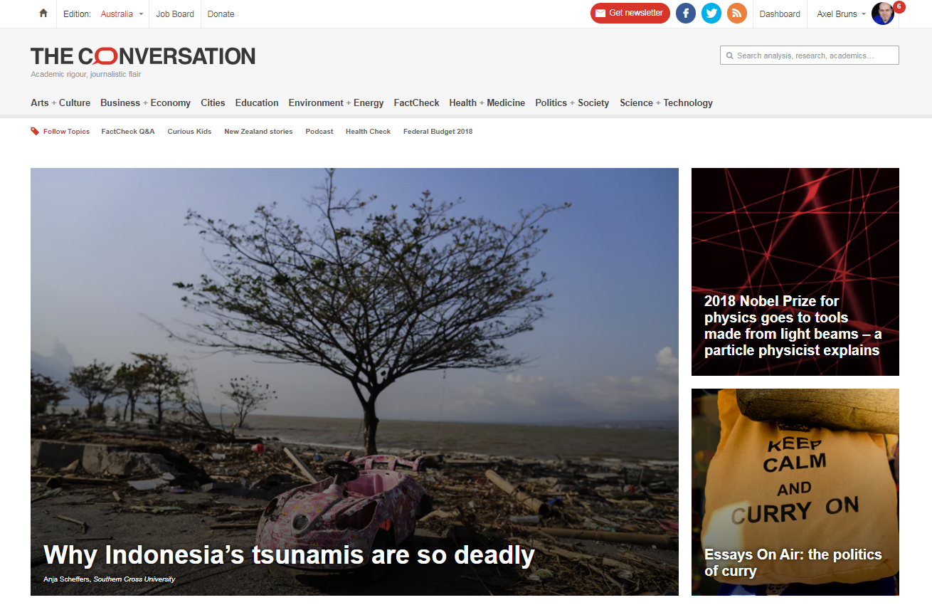

Slide 6
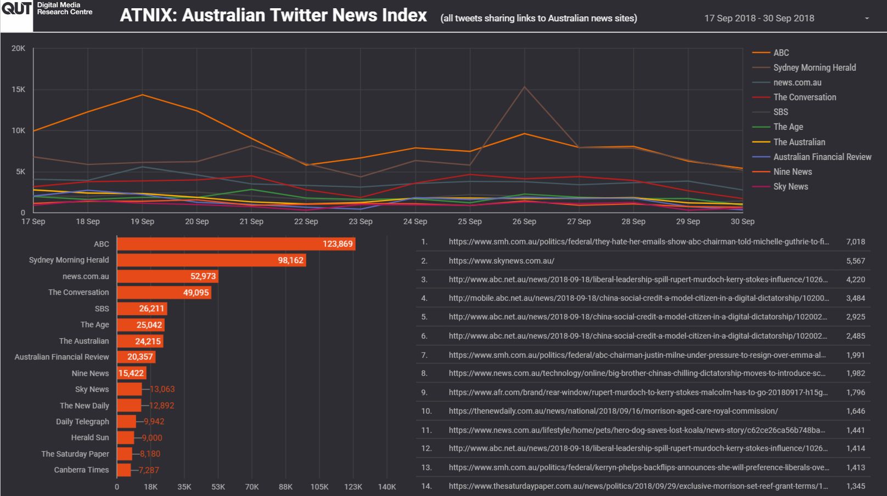

Slide 7
Some Findings

Slide 8
Benefits Identified…
“I think my own scientific writing has benefitted a little bit from it. Like telling the story, writing something that you know can grab someone’s attention quickly…. Probably more so for writing grants I guess. So I’ll tell the story and I’ll compel the panel why they should be giving me money for my project…”
“I mean I have a real interest in making sure that science is perceived as fun and interesting and not hard and boring.”
“I see it as a kind of an ethical or political imperative to engage.”

Slide 9
…But Not in All Fields
“So our communication's focus is very much on stakeholder communications, student communications. You know, PhDs and things like that.”
“Well it really depends when things become patented and licensed and things like that as to when we can actually start really talking about it.”
“But we do use a bit of social media but it's not at this point in time a priority for us either because it just does not align with what we're trying to do.”

Slide 10
@snurb_dot_info – http://snurb.info/
@socialmediaQUT – http://socialmedia.qut.edu.au/ @qutdmrc – https://www.qut.edu.au/research/dmrc
This research is supported by the ARC Linkage project “Amplifying Public Value: Scholarly Contributions’ Impact on Public Debate”, and the ARC LIEF project “TrISMA: Tracking Infrastructure for Social Media Analysis.”
Axel Bruns | @snurb_dot_info
ACEMS Impact Workshop, Brisbane, 4 Oct. 2018

